Slide 1
An introduction to stochastic programming
H.I. Gassmann

Slide 2
Overview
Introduction
A taxonomy of stochastic programming problems
Algorithms
Instance representations
An XML format for stochastic programs
Conclusions

Slide 3
Stochastic programming
Decision making under uncertainty
Very general class of problems:
  How to create and manage a portfolio
    Optimal investment sequences, given
      Historic distribution of returns and covariances
      Horizon, financial goals, regulatory constraints, etc.
  How to harvest a forest
    Optimal harvest sequence, given
      Random incidence of forest fires, pest, etc.
  How to generate power
    Random data on demand, rates, parameters
  etc.

Slide 4
Common characteristics
Large-scale optimization models
Some problem parameters unknown
Assume distribution of parameters known
(Otherwise: Optimization under risk)

Slide 5
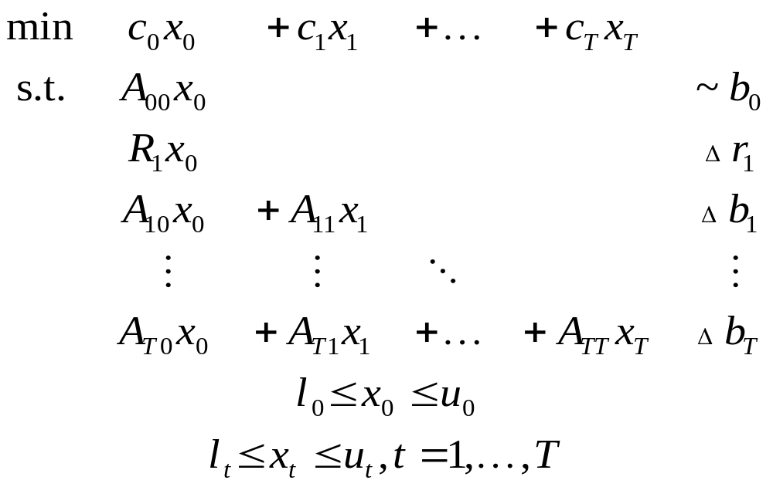
Multistage stochastic linear program
“ ”
Any data item with nonzero subscript may be random
(including dimensions where mathematically sensible)
~ stands for arbitrary relation (≤, =, ≥)

Slide 6
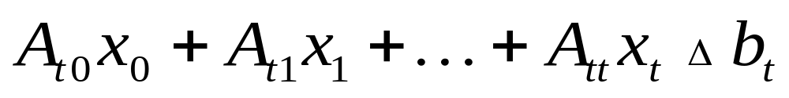
Constraints involving random elements
Δ means ~ with probability 1
or with probability at least β
or with expected violation at most v
or …
Notes:
Probability 1: Deterministic constraint or almost surely
Probability β: Probabilistic constraint (VaR)
Expected violation: CVaR

Slide 7
Problem classes
Recourse problems
  All constraints hold with probability 1
  Minimize expected objective value
Chance-constrained problems
  Typically single stage
Hybrid problems
  Recourse problems including probabilistic constraints (VaR) or integrated chance constraints (CVaR)
  Regulatory necessity
  Often modelled using integer variables and/or linking constraints
Distribution problems
  Determine distribution of optimum objective and/or decisions

Slide 8
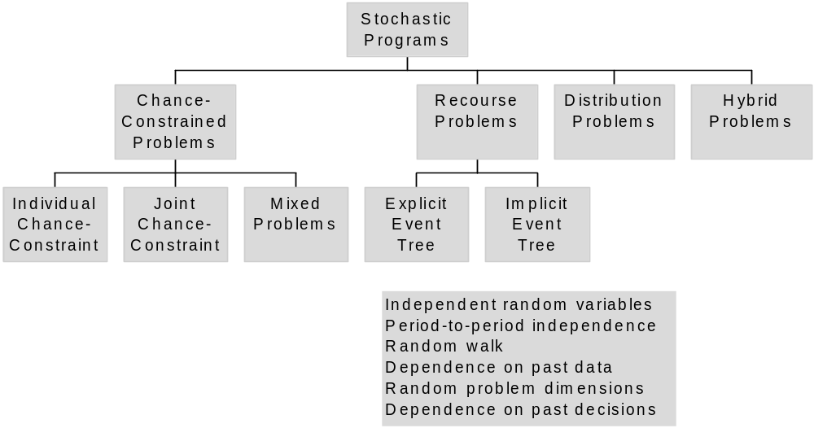
Taxonomy of stochastic programming problems

Slide 9
Event trees for finite distributions
Display evolution of information

Slide 10
Algorithms for recourse problems
Direct solution of the deterministic equivalent
  “Curse of dimensionality”
Decomposition
  Recognize structure
  Repeated calls to solver with different data
  Configuration and sequencing of subproblems
Notes:
Structure in stochastic programs is both temporal and stochastic (ie., two-dimensional in tree format)

Slide 11
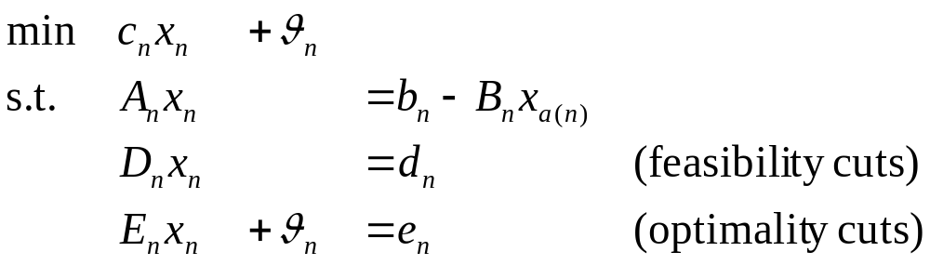
Benders Decomposition
Decompose event tree into nodal problems:
In sequence solve each problem repeatedly
Pass primal information to successors
Pass dual information to ancestors (cuts)

Slide 12
Algorithm variants
Different decomposition schemes
  Path by path
  Several stages at once
  etc.
Stochastic decomposition
  Sequential sampling of subproblems
  Suitable for continuous distributions
  Convergence in probability

Slide 13
Numerical results
Problem 1: WATSON
  Ten-stage financial investment problem
  Various numbers of scenarios
  Largest DE: around 700,000 variables
Problem 2: STOCHFOR
  Stochastic forestry problem
  Varying number of time stages
  Largest DE: around 500,000 variables

Slide 14
Problem characteristics
 | StochFor |  |  |  | Watson
stages | 7 | 8 | 9 | 10 | 10 | 10 | 10 | 10
scenarios | 729 | 2,187 | 6,561 | 19,683 | 16 | 128 | 768 | 2,688
nodes | 1,093 | 3,280 | 9,841 | 29,524 | 111 | 511 | 1,534 | 5,363
nrows | 19,672 | 59,038 | 177,136 | 531,430 | 4,684 | 26,748 | 102,132 | 357,376
ncols | 17,487 | 52,479 | 157,455 | 472,383 | 8,401 | 49,153 | 191,994 | 671,861
nelem (DE) | 76,467 | 229,557 | 688,827 | 2,066,637 | 21,368 | 128,648 | 526,078 | 1,841,028

Slide 15
Watson problem – CPU time
 | scenarios
configuration | 16 | 128 | 768 | 2688
cplex | 0.25 | 1.86 | 9.19 | 64.52
cplex-b | 0.19 | 2.5 | 17.5 | 90.09
nodes | 0.59 | 4.2 | 18.33 | 74.78
path | 3.91 | 16.58 | 44.59 | 191.02
3-ply | 1.41 | 12.55 | 50.59 | N.C.

Slide 16
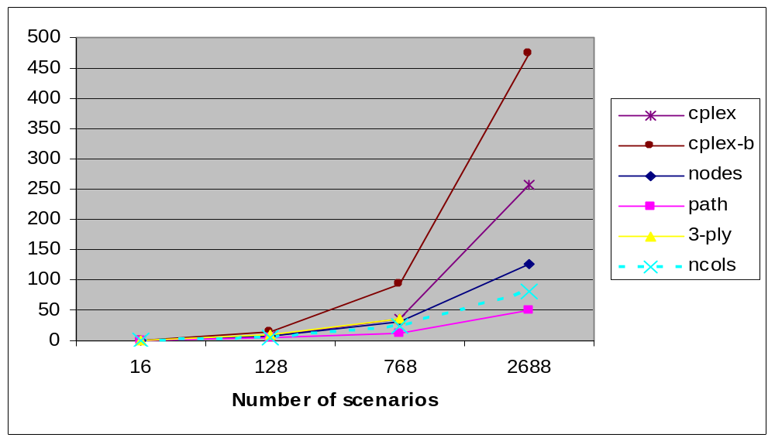
Watson problem - complexity

Slide 17
StochFor problem – CPU time
 | Periods
configuration | 7 | 8 | 9 | 10
cplex | 1.67 | 8.61 | 101.97 | 530.89
cplex-b | 1.27 | 5.81 | 33.03 | 298.64
nodes | 2.03 | 3.39 | 11.64 | 38.56
path | 2.42 | 7.09 | 20.72 | 129.28
3-ply | 16.69 | 27.52 | 202.02 | 549.72

Slide 18
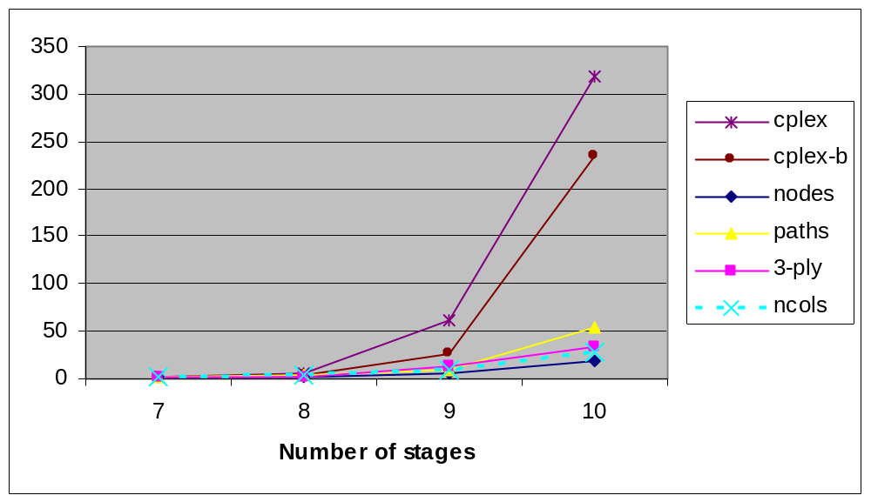
StochFor problem - complexity

Slide 19
Modelling support
Often O(10⁶) variables and constraints
Need computer support
  Algebraic modelling language (AML)
    How to express random entities?
    How to work with random entities?
  Databases
    How to link to AMLs?
  Visualization
    How to present solution and other problem components?
Notes:
Change blocks cannot be used if the problem dimensions are stochastic (e.g., some decisions are not available if adverse events have happened)

Slide 20
What is an instance?
Role and number of constraints, objectives, parameters and variables must be known
Every parameter’s value must be known
Continuous entities vs. discretization
  Decision variables
  Objective and constraints
  Distribution of random variables
  Time domain

Slide 21
What is a stage?
Stages form a subset of the time structure
Stages comprise both decisions and events
Events must either precede all decisions or follow all decisions
Should a stage be decision – event or event – decision?

Slide 22
Why is there a problem?
AMPL-like declarations:
set time ordered;
param demand{t in time} random;
Production_balance {t in time}:
Inv[t-1] + product[t] >= demand[t] + Inv[t];
Is the constraint well-posed?
At least two possible interpretations
  Inv[t] set after demand[t] known: recourse form, well-posed
  Inv[t] set before demand[t] known: undeclared chance constraint

Slide 23
Instance representation
SMPS format
Algebraic modelling languages
Internal representations
XML format

Slide 24
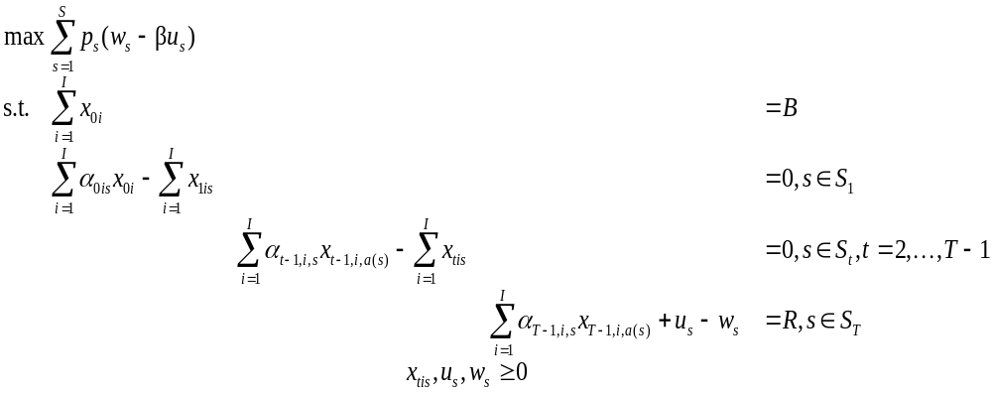
Example (Birge)
S0
S1
S₂
I = 2, T = 3, B = 55, R = 80,
α_{t1} = {1.25, 1.06},
α_{t2} = {1.14, 1.12}
…

Slide 25
SMPS format
Three files based on MPS format
  Core file for deterministic problem components
  Time file for dynamic structure
  Stoch file for stochastic structure
Disadvantages
  Old technology
  Limited precision (12 digits, including sign)
  Limited name space (8 characters)
  Direction of optimization (min/max) ambiguous
  Linear constraints, quadratic objective only

Slide 26
Example (Birge)
Core file
ROWS
Budget0
Object
Budget1
Budget2
Budget3
COLS
X01 Budget0 1.0
X01 Budget1 1.25
...
RHS
rhs1 Budget0 55.
rhs1 Budget3 80.
ENDATA
Stoch file
BLOCKS DISCRETE
BL Block1 0.5
X01 Budget1 1.25
X02 Budget1 1.14
BL Block1 0.5
X01 Budget1 1.06
X02 Budget1 1.12
BL Block2 0.5
X11 Budget2 1.25
X12 Budget2 1.14
...
ENDATA

Slide 27
Algebraic modelling languages
Characteristics
  Similar to algebraic notation
  Powerful indexing capability
  Data verification possible
Disadvantages
  Discrete distributions only
  Limited consistency checks for stochastic structure

Slide 28
AMPL model
param T;
param penalty;
param budget;
param target;
set instruments;
set scenarios;
param prob{scenarios};
set slice{t in 0..T} within scenarios;
param ancestor {t in 1..T, s in slice[t]};
var over {slice[T]};
var under{slice[T]};
param return {t in 1..T, i in instruments,s in slice[t]};
var invest {t in 0..T-1,i in instruments,s in slice[t]};
maximize net_profit:
sum{s in scenarios} prob[s]*(over[s] - penalty*under[s]);
subject to wealth{t in 0..T, s in slice[t]}:
(if t < T then sum{i in instruments} invest[t,i,s]) =
(if t = 0 then budget
else sum {i in instruments}
return[t,i,s]*invest[t-1,i,ancestor[t,s]])
+ if t = T then (under[s] - over[s] + target);

Slide 29
Internal representations
Seek most compact representation possible
  Sparse matrix format is insufficient
  Blocks corresponding to nodes in the event tree
  Change blocks if problem dimensions are deterministic
  A_{stj} = A_{st0} + ΔA_{stj} (addition or replacement)
  Exploit period-to-period independence
Notes:
Change blocks cannot be used if the problem dimensions are stochastic (e.g., some decisions are not available if adverse events have happened)

Slide 30
Storage requirements
 | Watson |  |  |  | Forest
stages | 10 | 10 | 10 | 10 | 7 | 8 | 9 | 10
scenarios | 16 | 128 | 768 | 2,688 | 729 | 2,187 | 6,561 | 19,683
nodes | 111 | 511 | 1,534 | 5,363 | 1,093 | 3,280 | 9,841 | 29,524
nrows | 4,684 | 26,748 | 102,132 | 357,376 | 19,672 | 59,038 | 177,136 | 531,430
ncols | 8,401 | 49,153 | 191,994 | 671,861 | 17,487 | 52,479 | 157,455 | 472,383
nelem (DE) | 21,368 | 128,648 | 526,078 | 1,841,028 | 76,467 | 229,557 | 688,827 | 2,066,637
nelem (blk) | 21,368 | 128,648 | 526,078 | 1,841,028 | 43,887 | 131,397 | 393,867 | 1,181,217
ch_blocks | 8,283 | 45,695 | 184,800 | 638,695 | 30,783 | 92,049 | 275,787 | 826,941
indep |  |  |  |  | 927 | 1,077 | 1,227 | 1,377

Slide 31
OSiL – Optimization Services instance Language
Written in XML
  Easy to accommodate new features
  Existing parsers to check syntax
Easy to generate automatically
Trade-off between verbosity and human readability

Slide 32
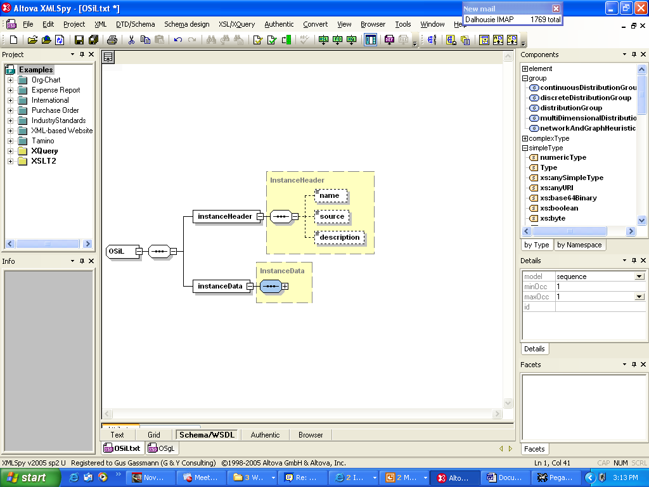
OSiL – Header information

Slide 33
OSiL – Header information
<?xmlversion="1.0"encoding="UTF8"?>
<OSiL xmlns="os.optimizationservices.org“
xmlns:xsi=http://www.w3.org/2001/XMLSchemainstance
xsi:schemaLocation="OSiL.xsd">
<programDescription>
<source>FinancialPlan_JohnBirge</source>
<maxOrMin>max</maxOrMin>
<objConstant>0.</objConstant>
<numberObjectives>1</numberObjectives>
<numberConstraints>4</numberConstraints>
<numberVariables>8</numberVariables>
</programDescription>
<programData>
...
</programData>
</OSiL>

Slide 34
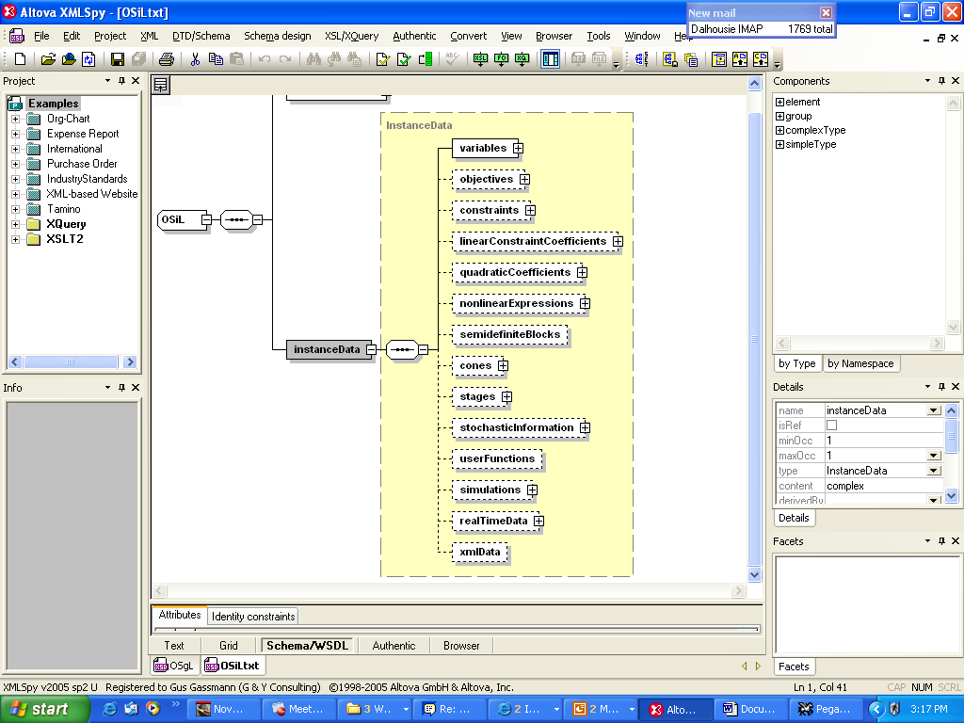
OSiL – Deterministic information
…

Slide 35
OSiL – Program data –
Constraints and variables
<constraints>
<con name="budget0“ lb="55“ ub="55"/>
<con name="budget1“ lb="0“ ub="0"/>
<con name="budget2“ lb="0“ ub="0"/>
<con name="budget3“ lb="80“ ub="80"/>
</constraints>
<variables>
<var name="invest01“ type="C“ lb="0.0"/>
<var name="invest02"/>
<var name="invest11"/>
<var name="invest12"/>
<var name="invest21"/>
<var name="invest22"/>
<var objCoef="1“ name="w"/>
<var objCoef=“-4“ name="u"/>
</variables>

Slide 36
OSiL –
Core matrix (sparse matrix form)
<coefMatrix>
<listMatrix>
<start>
<el>0</el>
<el>2</el>
<el>4</el>
<el>6</el>
<el>8</el>
<el>10</el>
<el>12</el>
<el>13</el>
</start>
<rowIdx>
<el>0</el>
<el>1</el>
<el>0</el>
<el>1</el>
<el>1</el>
<el>2</el>
<el>1</el>
<el>2</el>
<el>2</el>
<el>3</el>
<el>2</el>
<el>3</el>
<el>3</el>
<el>3</el>
</rowIdx>
<value>
<el>1</el>
<el>-1.25</el>
<el>1</el>
<el>-1.14</el>
<el>1</el>
<el>-1.25</el>
<el>1</el>
<el>-1.14</el>
<el>1</el>
<el>-1.25</el>
<el>1</el>
<el>-1.14</el>
<el>1</el>
<el>1</el>
</value>

Slide 37
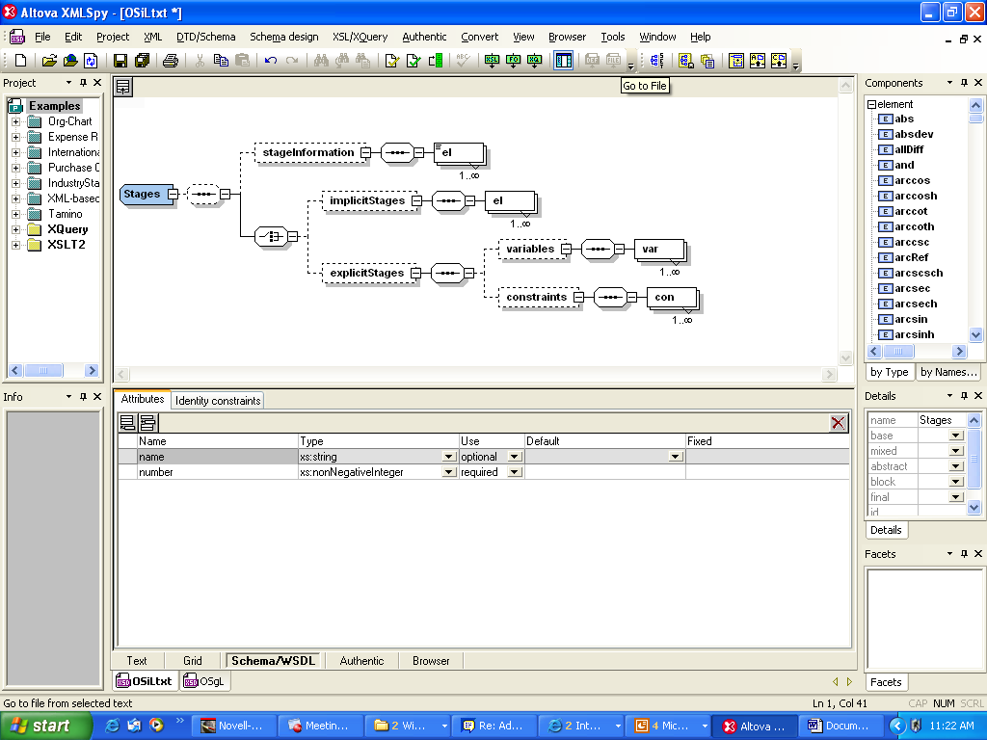
Dynamic structure

Slide 38
OSiL – dynamic information
<stages number="4">
<implicitOrder>
<el startRowIdx="0" startColIdx="0"/>
<el startRowIdx="1" startColIdx="2"/>
<el startRowIdx="2" startColIdx="4"/>
<el startRowIdx="3" startColIdx="6"/>
</implicitOrder>
</stages>

Slide 39
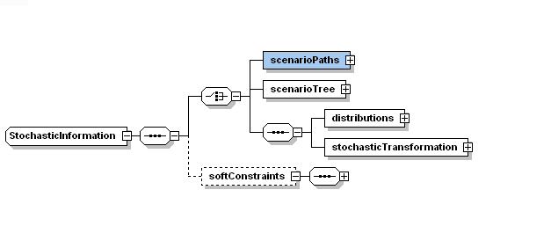
Explicit and implicit event trees

Slide 40
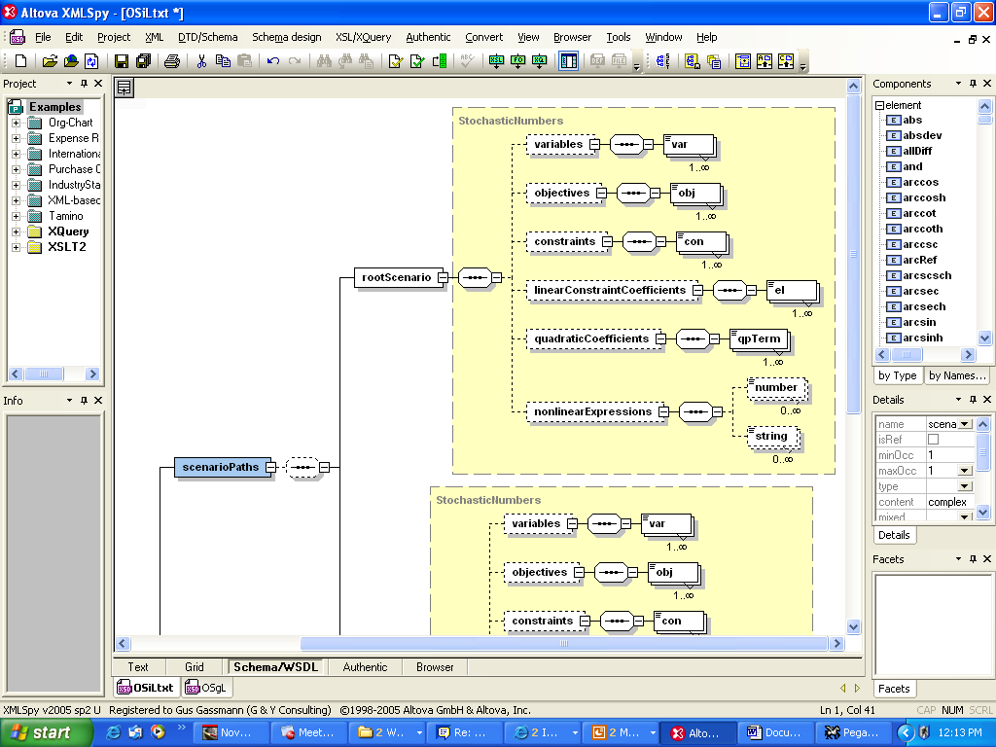
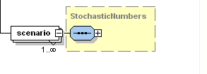
Scenario trees

Slide 41
OSiL – Stochastic information
<stochastic>
<explicitScenario>
<scenarioTree>
<sNode prob="1" base="coreProgram">
<sNode prob="0.5" base="coreProgram">
<sNode prob="0.5" base="coreProgram">
<sNode prob="0.5" base="coreProgram"/>
<sNode prob="0.5" base="firstSibling">
<changes>
<el rowIdx=“3" colIdx="4">-1.06</el>
<el rowIdx="3" colIdx="5">-1.12</el>
</changes>
</sNode>
</sNode>
…

Slide 42
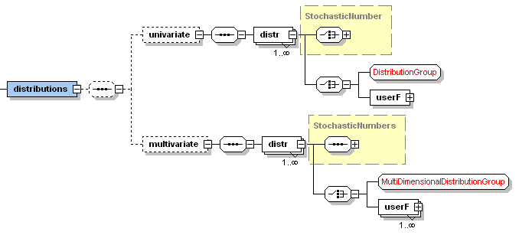
Distributions

Slide 43
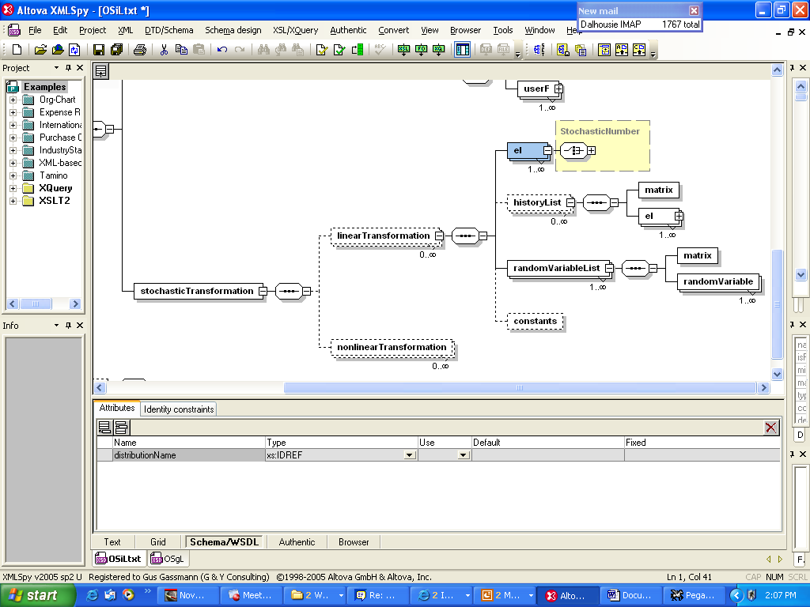
Transformations

Slide 44
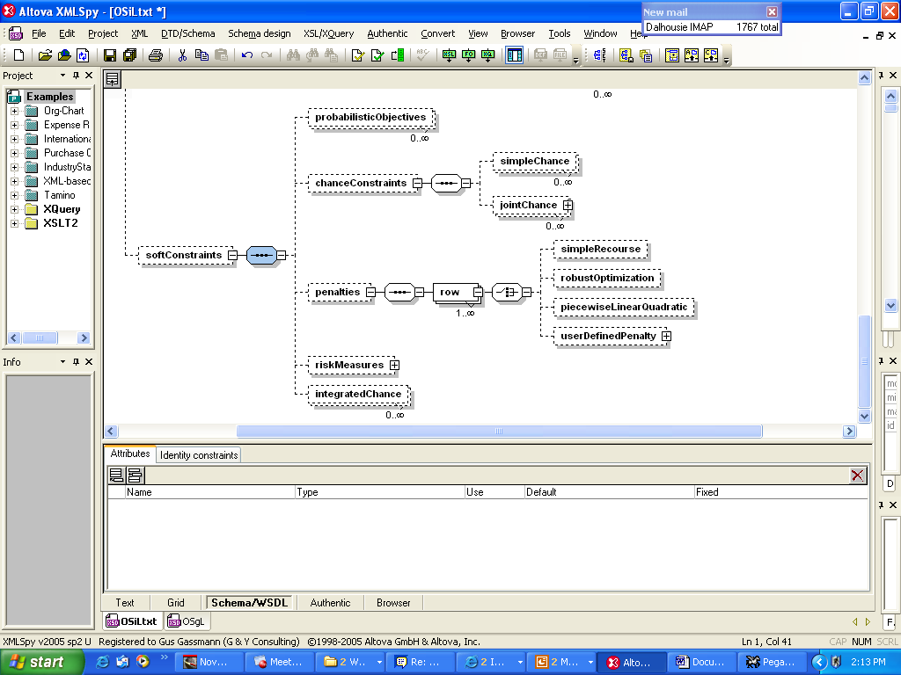
Penalties and probabilistic constraints

Slide 45
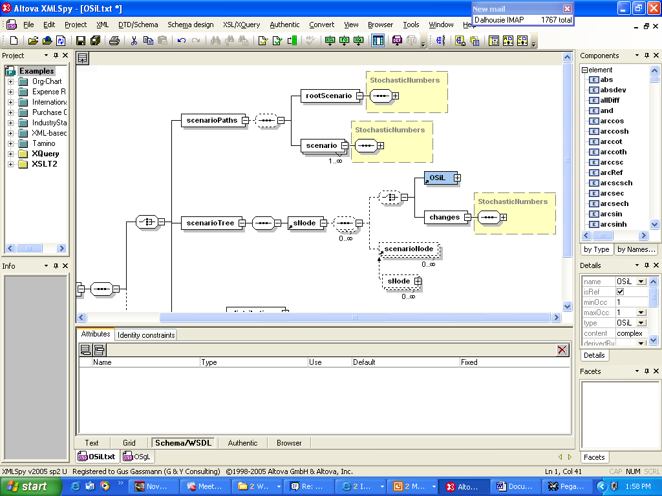
Node-by-node representation for stochastic problem dimensions

Slide 46
Capabilities
Arbitrary nonlinear expressions
Arbitrary distributions
Scenario trees
Stochastic problem dimensions
Simple recourse
Soft constraints with arbitrary penalties
Probabilistic constraints
Arbitrary moment constraints

Slide 47
Nonlinear expression –
(x₀ – x₁²)² + (1 – x₀)²
<plus>
<power>
<minus>
<var coef="1.0" idx="0"/>
<power>
<var coef="1.0" idx="1"/>
<number value="2"/>
</power>
</minus>
<number value="2"/>
</power>
<power>
<minus>
<number value="1"/>
<var coef="1.0" idx="1"/>
</minus>
<number value="2"/>
</power>
</plus>

Slide 48
Example – discrete random vector
<distributions>
<multivariate>
<dist name="dist1">
<multivariateDiscrete>
<scenario>
<prob>0.5</prob>
<el>-1.25</el>
<el>-1.14</el>
</scenario>
<scenario>
<prob>0.5</prob>
<el>-1.06</el>
<el>-1.12</el>
</scenario>
</multivariateDiscrete>
</dist>
</multivariate>
</distributions>

Slide 49
Further work
Readers
Internal data structures
Solver interfaces
Library of problems
Buy-in

Slide 50
Thank you!
www.optimizationservices.org
myweb.dal.ca/gassmann

